Slide 1
CSE 2451 string manipulation
Zichen Zhang

Slide 2
Overview
Revisiting C-style strings
string literals
ASCII encode
UTF-8, UTF-16, UTF-32
wide character
string.h
strlen
strchr
strcpy
strncpy
memcpy
memmove
strcmp
memcmp
memset
stdlib.h
atof
atoi, atol, atoll

Slide 3
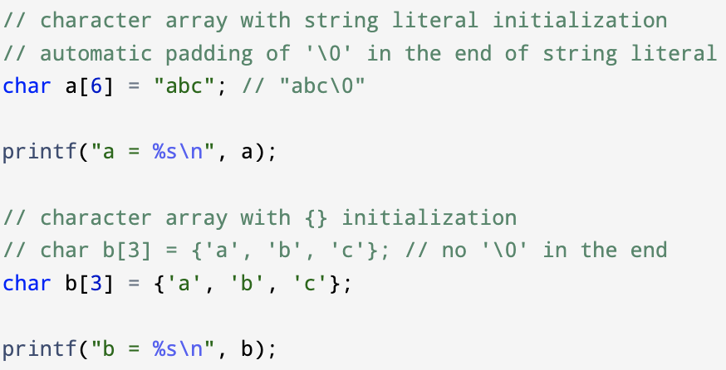

String – character Array with terminating ‘\0’
C-style string ⊊ character array
C-style string needs at least one terminating ‘\0’ character
printf() with %s will print a character array until reaching the 1st ‘\0’ character
Valid C-style string always terminates with a ‘\0’ character
Use %s as format specifier for a C-style string
Character array without ‘\0’ as its last element is not a valid C-style string, it’s just a character array

Slide 4

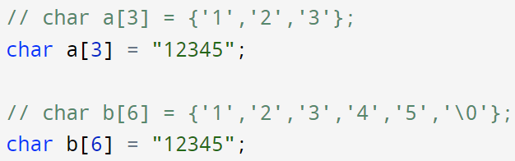
String – string literal
String literal constructs an unnamed character array when a character string needs to be embedded in the source code, a ‘\0’ terminator will be appended to the end of the string
We can use a “pointer to char” (char *) to point to such an unnamed character array
String literal can also be used to initialize a character array
If the size of the character is smaller than the size of the string literal (including ‘\0’), the remaining characters including the ‘\0’ terminator in the string literal is ignored in the character array

Slide 5
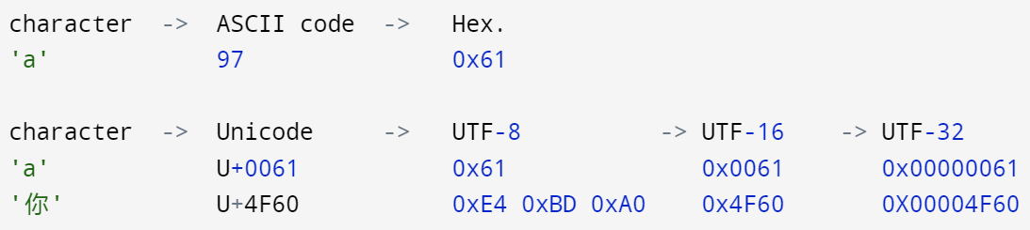

String – different types of string literals
ASCII code: mapping between 1 8-bit byte to a character, contains a maximum of 256 characters
Unicode: Use abstract codepoint to represent a character. Unicode contains over a million distinct codepoints, is a superset of all characters. We can then encode these codepoints with varying number of bytes
There are different types of string literals:
ASCII:
character string literal: e.g., char str[] = “Hello, world!”; // each character is stored in 1 byte char type
Unicode (C11 standards, #include <uchar.h>):
UTF-8 string literal: e.g., char str[] = u8”Hello world!” // each Unicode is stored in 1 byte char type
UTF-16 string literal: e.g., char str[] = u”Hello, world!” // each Unicode is stored in 2 bytes char16_t type
UTF-32 string literal: e.g., U”Hello, world!” // each Unicode is stored in 4 bytes char32_t type
Wide character (compiler specific):
Wide string literal: e.g., L”Hello, world!” // each wide code is stored as wchar_t type, sizeof(wchar_t) is implementation dependent
$${\text{(4}\text{F}\text{60)}}_{16}\text{=}{\text{20320}}_{10}$$
$$2^{8}<203020<2^{16}$$

Slide 6
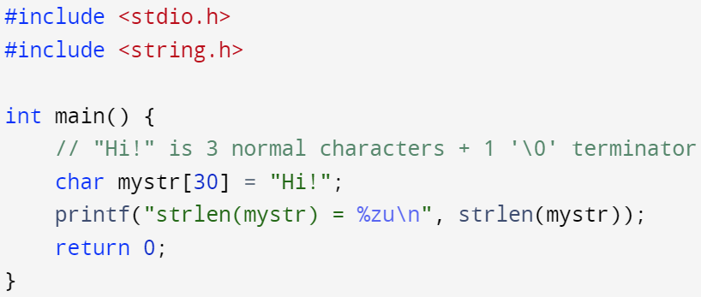

#include <string.h> - strlen
size_t strlen(const char *str);
Calculate the size of a C-style string, need #include <string.h>
strlen(str) count the number of characters in string str up to, but NOT including the ‘\0’ terminator
If str is not pointing to a ‘\0’ terminating character array → undefined behavior
It’s safer to use the designated format specifier %zu to print size_t typed value instead of using %u or %d

Slide 7
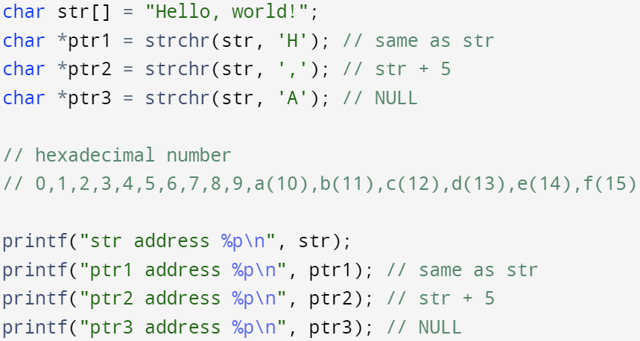
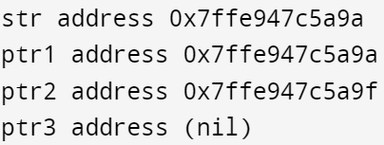
#include <string.h> - strchr
char * strchr (const char * str, int ch);
Starting at str, searching for the 1st appearance of the specified character ch in string str
ch can be an integer storing ASCII code or character literal, e.g., ‘A’, ‘1’, etc.
Return a pointer to the address of the 1st appearance of ch in str, return NULL if no such character is found in str
The ‘\0’ terminator is a part of the string and can be found when searching for ‘\0’ (i.e., ch = 0)
If str is not a C-style string with ‘\0’ terminator → undefined behavior
Hexadecimal number: a + 5 = f

Slide 8
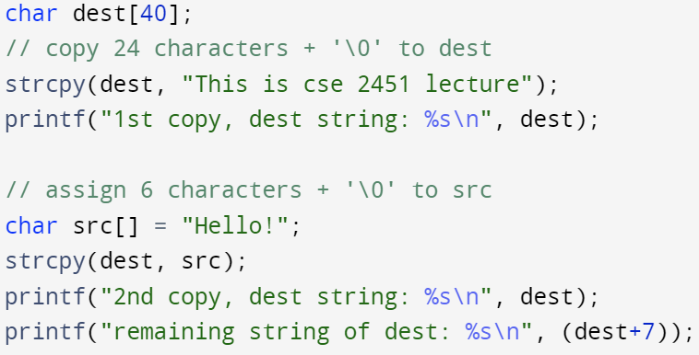
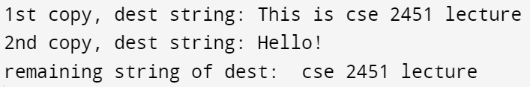
#include <string.h> - strcpy
char * strcpy (char * dest, const char * src);
Copies characters from src to dest, including the ‘\0’ terminator character in src
The dest string must be long enough to contain the src string, otherwise → undefined behavior
Return a pointer to the starting address pointed by dest
If the character arrays dest and src overlap → undefined behavior
The original dest character array’s first 7 characters are overwritten by the 2nd strcpy
If we pass the starting address of dest to printf(), it only prints the first 6 character before reaching ‘\0’, if we pass the 8th character’s address to printf(), it will reach the 2nd ‘\0’ after “lecture”

Slide 9
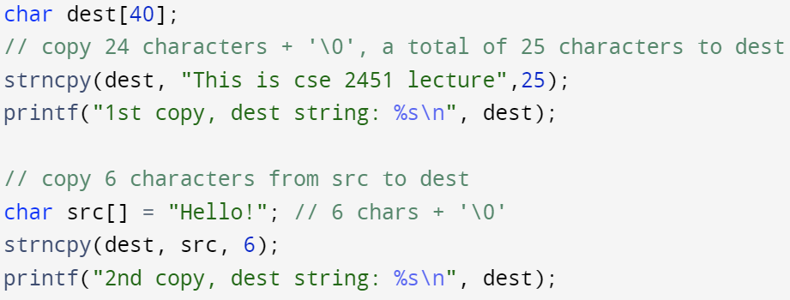

#include <string.h> - strncpy
char * strncpy (char * dest, const char * src, size_t num);
Copies num characters from src to dest. If num > strlen(src), pads remaining dest string with ‘\0’s until reaching num characters
The dest string must be long enough to hold the specified num characters, otherwise → undefined behavior
Return a pointer to the starting address pointed by dest
If the character arrays dest and src overlap → undefined behavior
Only 6 characters is copied in the 2nd strncpy, therefore ‘\0’ in “Hello!” is not included

Slide 10
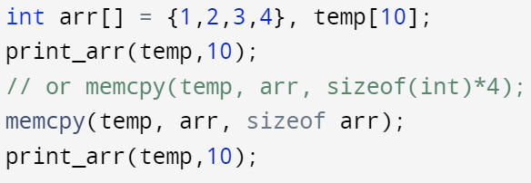
#include <string.h> - memcpy
void * memcpy (void * dest, const void * src, size_t num);
Copies num bytes of data from src address (memory area) to dest address (memory area)
Both objects pointed by dest and src are interpreted as arrays of unsigned char
Both objects pointed by dest and src must have size >= num bytes, otherwise → undefined behavior
memcpy is more general than strncpy, the variable passed to memcpy is not limited to character arrays
Return a pointer to the starting address pointed by dest
If the memory blocks pointed by dest and src overlap → undefined behavior

Slide 11
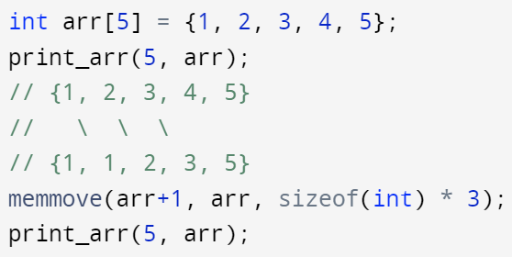

#include <string.h> - memmove
void * memmove (void * dest, const void * src, size_t num);
Copies num bytes of data from src address to dest address
Both objects pointed by dest and src are interpreted as arrays of unsigned char
Both objects pointed by dest and src must have size >= num bytes, otherwise → undefined behavior
Return a pointer to the starting address pointed by dest
The memory blocks pointed by dest and src may overlap → Copying take place as if the characters were copied to a temporary character array and then the characters were copied from the temporary array to dest

Slide 12
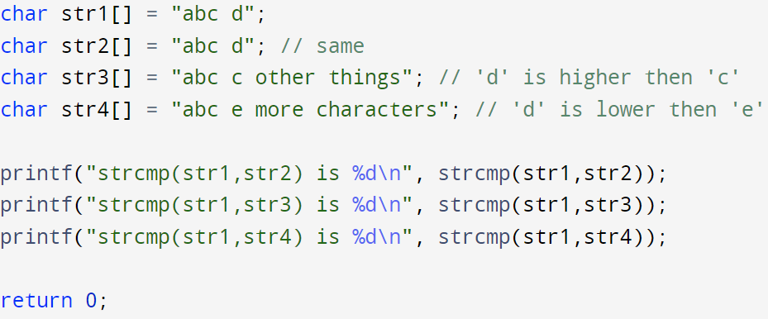
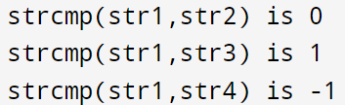
#include <string.h> - strcmp
int strcmp (const char * str1, const char * str2);
Compares two strings, returns 0 if two strings are equal, otherwise return a non-zero value
The sign of the returned non-zero value is the sign of difference between the values of the first pair of characters that differ in the strings being compared
This function alleviates the burden to write your own for-loop to compare 2 strings

Slide 13
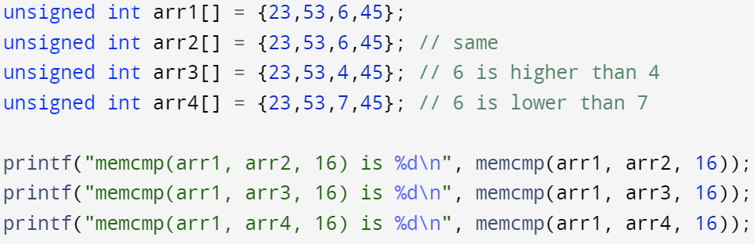
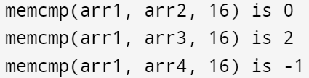
#include <string.h> - memcmp
int memcmp (const void * str1, const void * str2, size_t num);
Compares any kind of objects, both objects pointed by str1 and str2 are interpreted as arrays of unsigned char
Returns 0 if two objects stored the same data, otherwise returns a non-zero value
The sign of the returned non-zero value is the sign of difference between the values of the first pair of characters that differ in the strings being compared
This function can be used to compare two arrays directly

Slide 14
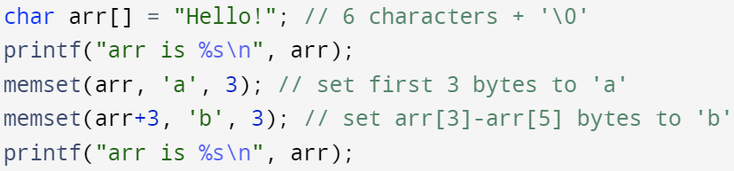
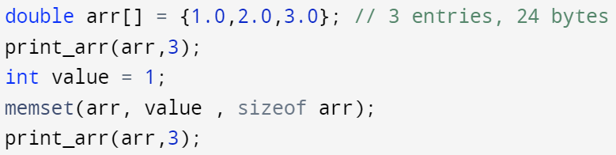


#include <string.h> - memset
void * memset (void * dest, int value, size_t num);
Starting at dest, going forward num bytes, setting each byte of memory to value
value is interpreted as unsigned char inside memset
Can be used to zero-out a chunk of memory (useful for security)
Returns a pointer storing the address of dest
Note, the binary representation of different data types are different, byte-wise memset to value is interpreting each byte as unsigned char

Slide 15
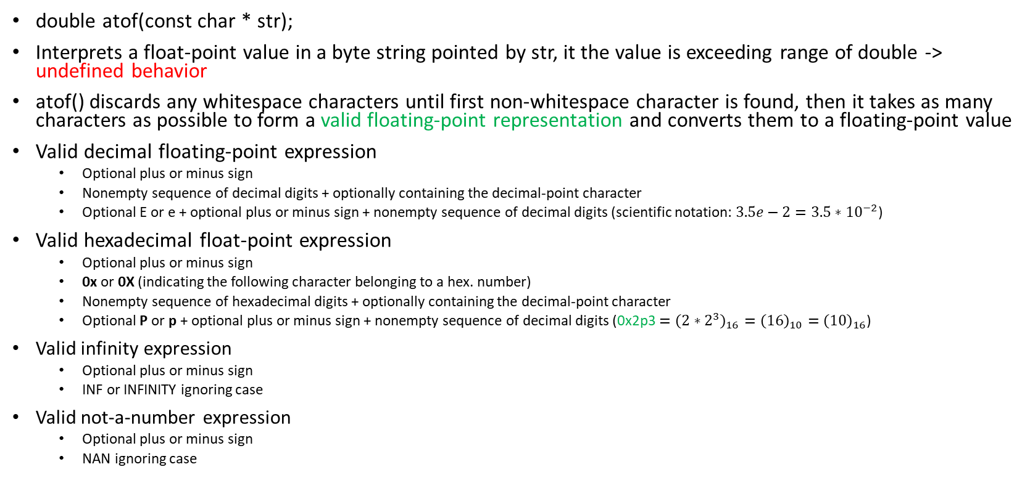
#include <stdlib.h> - atof
double atof(const char * str);
Interprets a float-point value in a byte string pointed by str, it the value is exceeding range of double -> undefined behavior
atof() discards any whitespace characters until first non-whitespace character is found, then it takes as many characters as possible to form a valid floating-point representation and converts them to a floating-point value
Valid decimal floating-point expression
Optional plus or minus sign
Nonempty sequence of decimal digits + optionally containing the decimal-point character
Optional E or e + optional plus or minus sign + nonempty sequence of decimal digits (scientific notation: ${3.5e−2=3.5∗10}^{−2}$)
Valid hexadecimal float-point expression
Optional plus or minus sign
0x or 0X (indicating the following character belonging to a hex. number)
Nonempty sequence of hexadecimal digits + optionally containing the decimal-point character
Optional P or p + optional plus or minus sign + nonempty sequence of decimal digits (0x2p3 $={\left(2∗2^{3}\right)}_{16}={\left(16\right)}_{10}={\left(10\right)}_{16}$)
Valid infinity expression
Optional plus or minus sign
INF or INFINITY ignoring case
Valid not-a-number expression
Optional plus or minus sign
NAN ignoring case

Slide 16
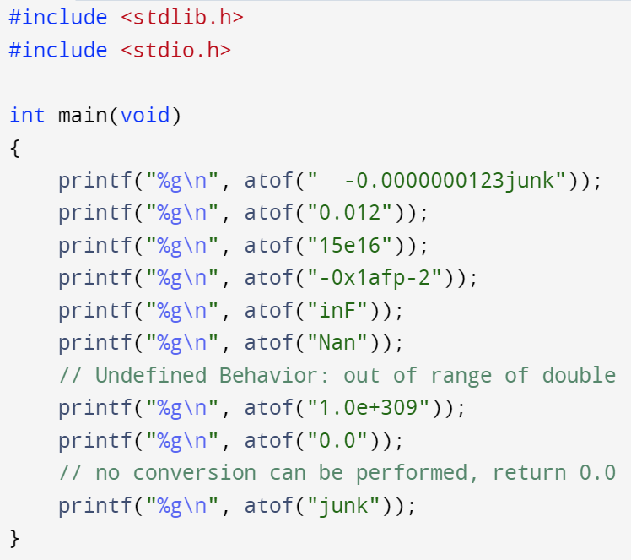
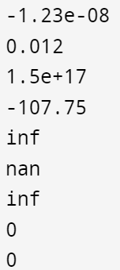
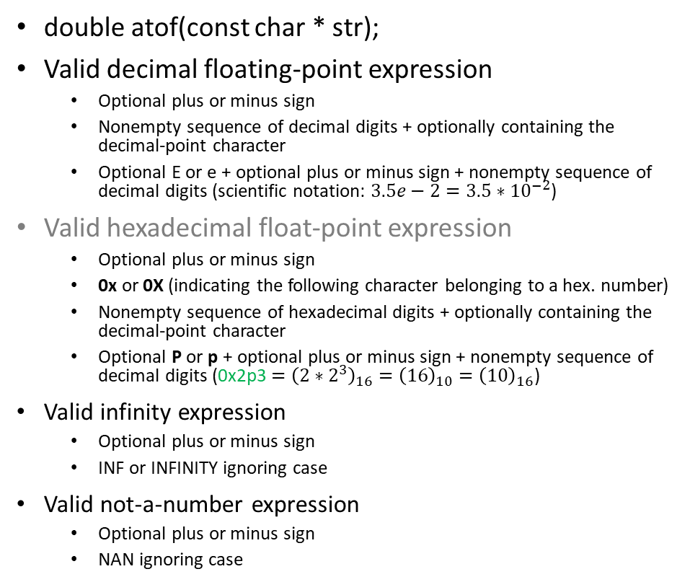
#include <stdlib.h> - atof (ASCII to float)
double atof(const char * str);
Valid decimal floating-point expression
Optional plus or minus sign
Nonempty sequence of decimal digits + optionally containing the decimal-point character
Optional E or e + optional plus or minus sign + nonempty sequence of decimal digits (scientific notation: ${3.5e−2=3.5∗10}^{−2}$)
Valid hexadecimal float-point expression
Optional plus or minus sign
0x or 0X (indicating the following character belonging to a hex. number)
Nonempty sequence of hexadecimal digits + optionally containing the decimal-point character
Optional P or p + optional plus or minus sign + nonempty sequence of decimal digits (0x2p3 $={\left(2∗2^{3}\right)}_{16}={\left(16\right)}_{10}={\left(10\right)}_{16}$)
Valid infinity expression
Optional plus or minus sign
INF or INFINITY ignoring case
Valid not-a-number expression
Optional plus or minus sign
NAN ignoring case
Using %g is similar to printing the value in either %f or %e depending on whichever format produce shorter output

Slide 17
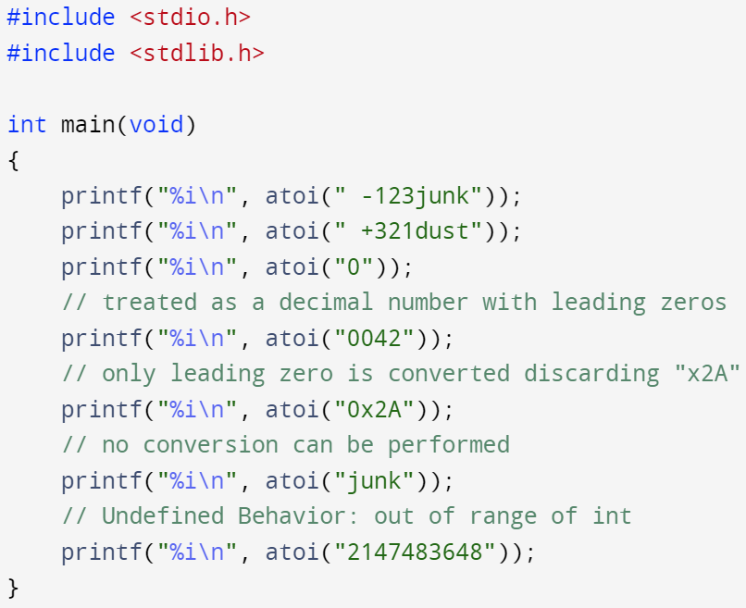
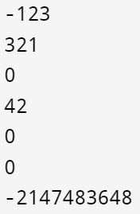
#include <stdlib.h> - atoi, atol, atoll (ASCII to integer)
int atoi (const char * str);
long int atol (const char * str);
long long atoll (const char * str);
Interprets integer value in a byte string pointed by str. The implied base is always 10
Discards any whitespace characters until first non-whitespace character is found, then it takes as many characters as possible to form a valid integer number representation and converts them to an integer value
Valid integer value consists of:
Optional plus or minus sign
Numeric digits (0~9) (leading zeros are discarded)

